Slide 1

Unit 3: Entrepreneurial Process And Decision Making

Slide 2
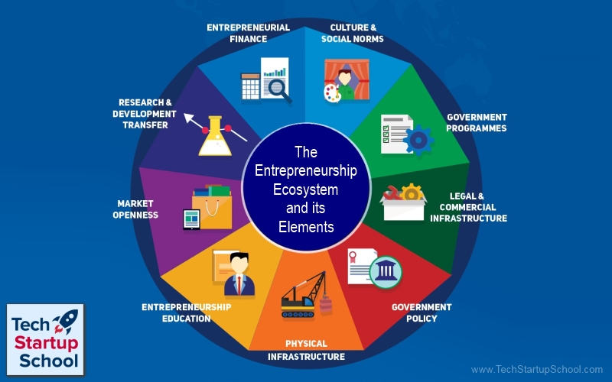
ENTREPRENEURSHIP ECOSYSTEM AND ITS ELEMENTS
Source: www.startupindia.gov.in/

Slide 3
An entrepreneurial ecosystem or entrepreneurship ecosystem is the social and economic environment affecting the local or regional entrepreneurship. Entrepreneurial ecosystems are defined as a set of interdependent actors and factors coordinated in such a way that they enable productive entrepreneurship within a particular territory. The entrepreneurial ecosystem often narrows entrepreneurship down to high-growth startups or scaleups, claiming that this type of entrepreneurship is an important source of innovation, productivity growth, and employment. Entrepreneurial ecosystem has nine elements or framework conditions in every territory or country, playing a role of catalyst for the entrepreneurial activities.
entrepreneurial finance,
government policy,
government entrepreneurship programs,
entrepreneurship education,
research & development transfer,
commercial & legal infrastructure,
market openness,
physical infrastructure, and
cultural & social norms.

Slide 4
Indian Startup Ecosystem
India has the 3rd largest startup ecosystem in the world; expected to witness YoY growth of a consistent annual growth of 12-15%
India has about 50,000 startups in India in 2018; around 8,900 – 9,300 of these are technology led startups 1300 new tech startups were born in 2019 alone implying there are 2-3 tech startups born every day.

Slide 5
Indicators of Growth in the Startup Ecosystem
The pace of growth in the startup ecosystem has increased to 15% year-on-year in 2018, while the growth of the number of incubators and accelerators has grown to 11%
Significantly, the number of women entrepreneurs stood at 14%, up from 10% and 11% in the previous two years.
Startups in the country have been able to create an estimated 40,000 new jobs over the year, taking the total jobs in the start-up ecosystem to 1.6-1.7 lakh
Bangalore has been listed within the world’s 20 leading startup cities in the 2019 Startup Genome Project ranking. It is also ranked as one of the world’s five fastest growing startup cities

Slide 6
Drivers of Startup Ecosystem
Corporate Connect:
Enterprises are realizing the disruptive potential of start-ups and are thus, partnering/investing in them. Examples of corporate support:
Facebook in partnership with Startup India disbursed cash grants of $50,000 each to the top 5 selected startups
10000 Women program by Goldman Sachs is providing women entrepreneurs all around the world with a business and management education, mentoring and networking and access to capital.
Microsoft Ventures Accelerator Program in India has recently picked up 16 startup
Government Support:
Government of India is understanding the value of working with disruptive innovators across the value chain and using their innovations to improve public service delivery.
Department of Animal Husbandary and Dairying has conducted a grand challenge in association with Startup India to award top startups in 5 categories 10 lakhs INR.
Small Industries Development Bank of India has launched a scheme to provide assistance to existing Small and Medium Businesses in need of capital for growth
Over 26 states in the country have Startup policies

Slide 7
Ideation, Development and Exploitation of Opportunities
Feasibility Analysis

Slide 8
What is Feasibility Analysis
Feasibility analysis is the process of determining whether a business idea is viable.
It is the preliminary evaluation of a business idea, conducted for the purpose of determining whether the idea is worth pursuing.
Feasibility analysis takes the guesswork (to a certain degree) out of a business launch, and provides an entrepreneur a more secure notion that a business idea is feasible or viable.

Slide 9
Timing of Feasibility Analysis
The proper time to conduct a feasibility analysis is early in thinking through the prospects for a new business.
The thought is to screen ideas before a lot of resources are spent on them.

Slide 10
Preparing a Concept Statement
Before a company undertakes a feasibility analysis, a concept statement should be developed.
A concept statement is a one page description of a business, that is distributed by a startup entrepreneur to people who are asked to provide feedback on the potential of the business idea.
The feedback will hopefully provide the entrepreneur
a sense of the viability of the business idea
suggestions for how the idea can be strengthened or “tweaked” before proceeding further.

Slide 11
Preparing a Concept Statement
Information to Include
A description of the product or service being offered
The intended target market
The benefits of the product or service
A description of how the product will be positioned relative to similar ones in the market
A description of how the product or service will be sold and distributed
Information about the founder or founders of the firm

Slide 12
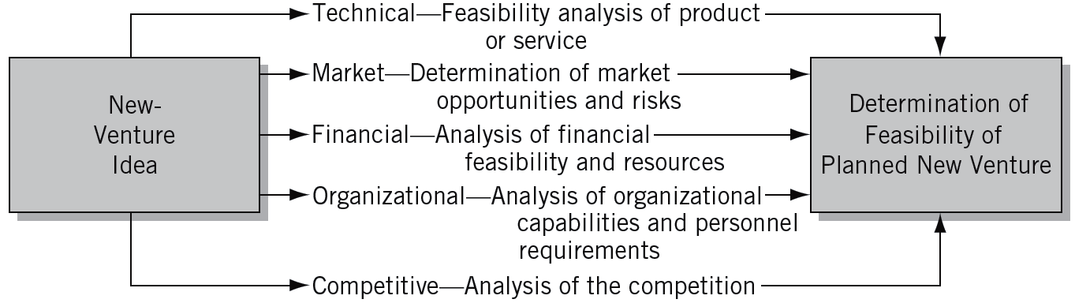
Key Areas for Assessing the Feasibility of a New Venture

Slide 13

Specific Activities of Feasibility Analyses
Technical Feasibility Analysis | Market Feasibility Analysis | Financial Feasibility Analysis | Organizational Capabilities Analysis | Competitive Analysis
Crucial technical specifications Design Durability Reliability Product safety Standardization Engineering requirements Machines Tools Instruments Work flow Product development Blueprints Models Prototypes Product testing Lab testing Field testing Plant location Desirable characteristics of plant site (proximity to suppliers, customers), environmental regulations | Market potential Identification of potential customers and their dominant characteristics (e.g., age, income level, buying habits) Potential market share (as affected by competitive situation) Potential sales volume Sales price projections Market testing Selection of test Actual market test Analysis of market Marketing planning issues Preferred channels of distribution, impact of promotional efforts, required distribution points (warehouses), packaging considerations, price differentiation | Required financial resources Fixed assets Current assets Necessary working capital Available financial resources Required borrowing Potential sources for funds Costs of borrowing Repayment conditions Operation cost analysis Fixed costs Variable costs Projected profitability | Personnel requirements Required skill levels and other personal characteristics of potential employees Managerial requirements Determination of individual responsibilities Determination of required organizational relationships Potential organizational development Competitive analysis | Existing competitors Size, financial resources, market entrenchment Potential reaction of competitors to newcomer by means of price cutting, aggressive advertising, introduction of new products, and other actions

Slide 14
Four Forms of Feasibility Analysis
Product/Service Feasibility Analysis
Industry/Market Feasibility Analysis
Organizational Feasibility Analysis
Financial Feasibility Analysis

Slide 15
Product/Service Feasibility Analysis
An assessment of the overall appeal of the product or service being proposed.
Before a prospective firm rushes a product or service into development, it should be confident that the product or service is what its prospective customers want.
The two components of a product/service feasibility analysis are:
Concept testing
Usability testing

Slide 16
Product/Service Feasibility Analysis
Concept Testing
A concept test involves showing a representation of the product or service to prospective users to gauge customer interest, desirability, and purchase intent.
A concept test is different from a concept statement (discussed earlier).
A concept test is limited to testing the feasibility of a specific product or service idea.
A concept statement is a preliminary evaluation of an entire business idea.

Slide 17
Product/Service Feasibility Analysis
Three purposes of conducting a concept test
Purpose | How it is accomplished
Validate the underlying premises of a product or service idea | This can be accomplished via phone interviews, personal interviews, and focus groups and simply by watching people perform relevant tasks.
Help develop an idea | A firm may show a product idea to a prospective customer, get feedback, and tweak the idea. Then, in an iterative manner, they’ll show the idea to more potential customers, get feedback and tweak the idea some more, and so on.
Estimate the potential market share the product or service might command | Some type of buying intention question appears in almost every concept test, usually in the form of a survey questionnaire.

Slide 18
Product/Service Feasibility Analysis
Usability Testing
Is the method by which users of a product are asked to perform certain tasks in order to measure the product’s ease-of-use and the user’s perception of the experience.
Usability tests are sometimes called user tests, beta tests, or field trials, depending on the circumstances involved.
While it is tempting to rush a new product or service to market, conducting a usability test is a good investment of an entrepreneur’s or firm’s resources.
Many products that consumers find frustrating to work with have been brought to market too quickly.

Slide 19
Product/Service Feasibility Analysis
Forms of usability testing
Form of usability test | Explanation
Basic prototype | Some entrepreneurs, with limited budgets, develop a fairly basic prototype and ask friends and colleagues to use the product, then complete an evaluation form or give feedback.
Elaborate usability test | Better funded companies have more elaborate usability tests. For example, in software usability-testing lab, participants are asked to work with software programs that are being developed, while “loggers” record usability problems.

Slide 20
Industry/Market Feasibility Analysis
An assessment of the overall appeal of the market for the product or service being proposed.
For industry/market feasibility analysis, there are three primary issues that a proposed business should consider:
Industry attractiveness
market timeliness
identification of a niche market.

Slide 21
Industry/Market Feasibility Analysis
Industry Attractiveness
A primary determinant of a new venture’s feasibility is the attractiveness of the industry it chooses.
In addition to evaluating an industry’s growth potential, a new venture will want to know more about the industry it plans to enter.
This can be accomplished through both primary and secondary research.

Slide 22
Industry/Market Feasibility Analysis
Characteristics of attractive industries for new ventures
Are large and growing (with growth being more important than size)
Are important to the customer
Are fairly young rather than older and more mature
Have high rather than low operating margins
Are not crowded

Slide 23
Industry/Market Feasibility Analysis
Primary research
research that is original and is collected by the entrepreneur.
Typically involves an entrepreneur talking to potential customers and key industry participants.
Secondary research
research that probes data that are already collected.
industry-related publications, government statistics, competitor’s Web sites, and industry reports from research firms

Slide 24
Industry/Market Feasibility Analysis
Market Timeliness Considerations
Nature of product or service introduction | Major Considerations
Improvement on something already available in the marketplace | Is the window of opportunity open or closed? Is now a good time for a new market entrant (i.e., are customers buying, are industry incumbents making money?)
Breakthrough new product or service, which should establish a new market segment | Should we try to capture a first-mover advantage?

Slide 25
Industry/Market Feasibility Analysis
Identification of a Niche Market
A niche market is a place within a larger market segment that represents a narrower group of customers with similar interests.
For a new firm, selling to a niche market makes sense for at least two reasons.
It allows a firm to establish itself within an industry without competing against major competitors head on.
A niche strategy allows a firm to focus on serving a specialized market very well instead of trying to be everything to everybody in a broad market, which is nearly impossible for a new entrant.

Slide 26
Organizational Feasibility Analysis
Determining whether the business has sufficient skills and resources to bring a particular product or service idea to market successfully.
There are two primary issues to consider in this area:
Management expertise
Resource sufficiency

Slide 27
Organizational Feasibility Analysis
Management Prowess
A firm should evaluate the prowess, or ability, of its management team to satisfy itself that management has the requisite passion and expertise to launch the venture.
Two of the most important factors in this area are:
The passion that the solo entrepreneur or the founding team has for the business idea.
The extent to which sole entrepreneur or the founding team understands the markets in which the firm will participate.
Sole entrepreneurs or founding teams with established social and professional networks have an advantage.

Slide 28
Organizational Feasibility Analysis
Resource Sufficiency
This pertains to an assessment of whether an entrepreneur has sufficient resources to launch the proposed venture.
The focus here should be on nonfinancial resources since financial feasibility is considered separately.
To test resource sufficiency, a firm should list the most critical nonfinancial resources that will be needed to move the business idea forward successfully.
If critical resources are not available in certain areas, it may be impractical to proceed with the business idea.

Slide 29
Organizational Feasibility Analysis
Nonfinancial resources that may be critical to the successful launch of a new business
Availability of affordable office or lab space
Likelihood of local and state government support of the business
Quality of the labor pool available
Proximity to key suppliers and customers
Willingness of high quality employees to join the firm
Likelihood of establishing favorable strategic partnerships
Proximity to similar firms for the purpose of sharing knowledge
Possibility of obtaining intellectual property protection in key areas

Slide 30
Financial Feasibility Analysis
The most important issues to consider at this stage are:
Capital requirements
Financial rate of return
Overall attractiveness of the investment

Slide 31
Financial Feasibility Analysis
Capital Requirements
In the feasibility analysis stage, it is important that an entrepreneur have a sense of what the business’s initial capital requirements will be.
The figure that is determined provides important information about the rate of return that can be anticipated from the business and about the type of financing or funding that will be needed.

Slide 32
Financial Feasibility Analysis
Financial Rate of Return
Although the estimate may be rough, an entrepreneur should have a sense of the rate of return that the proposed business will produce.
This figure can be determined in part by looking at the rate of return of similar businesses, and then adjusting upward or downward depending on the unique characteristics of the proposed business.

Slide 33
Financial Feasibility Analysis
Overall Attractiveness of the Investment
A number of other financial factors are associated with promising business startups.
In the feasibility analysis stage, the extent to which a business opportunity is positive relative to each factor is based on an estimate rather than actual performance.

Slide 34
Criteria for choosing project selection model
Realism
Capability
Flexibility
Ease of use
Cost
Easy computerization

Slide 35
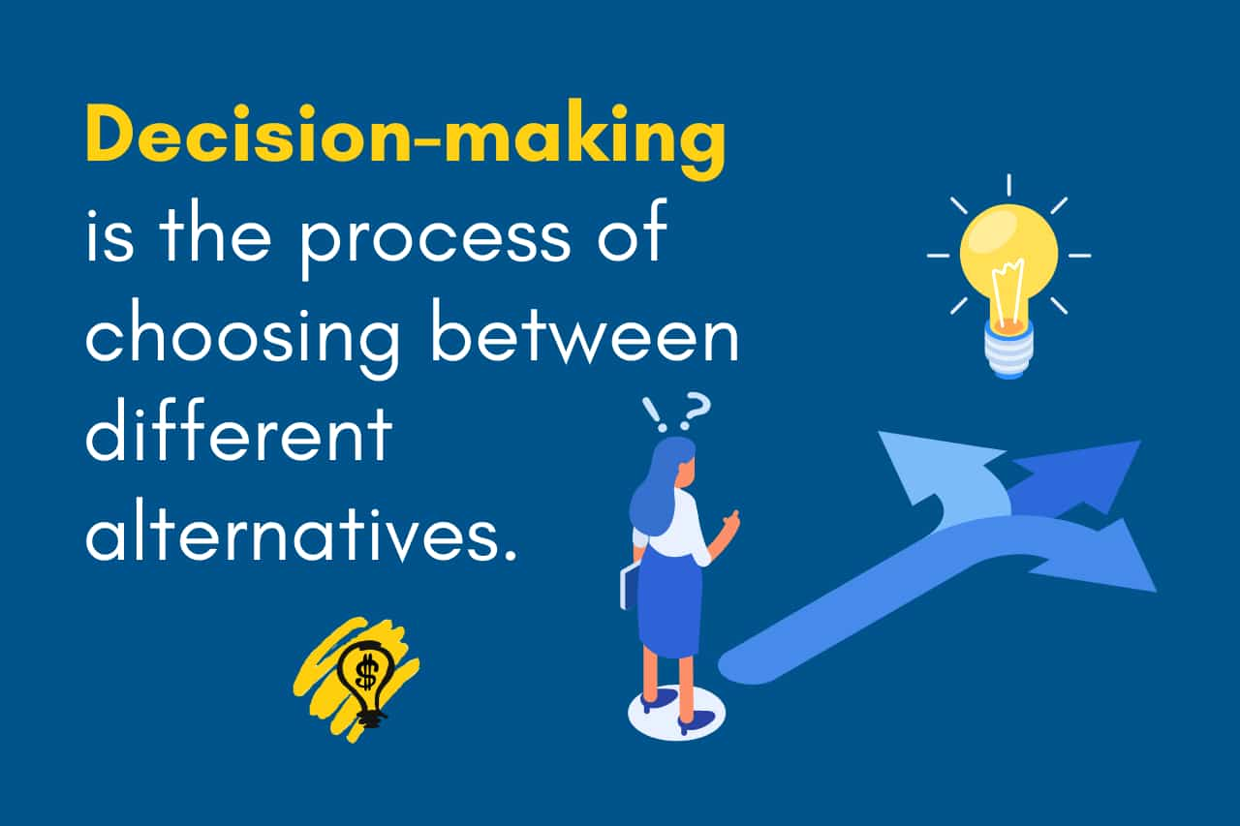
Decision Making Process and Approaches
Decisions are choices, or choices of the many things available to choose from. That thing can be an alternative, direction, solution, or path. So, decision-making is the process of choosing between different alternatives. It may mean choosing new business equipment, expanding in new markets, deciding what marketing tactics to use, or choosing to go solo or take a partner on your entrepreneurial journey.

Slide 36
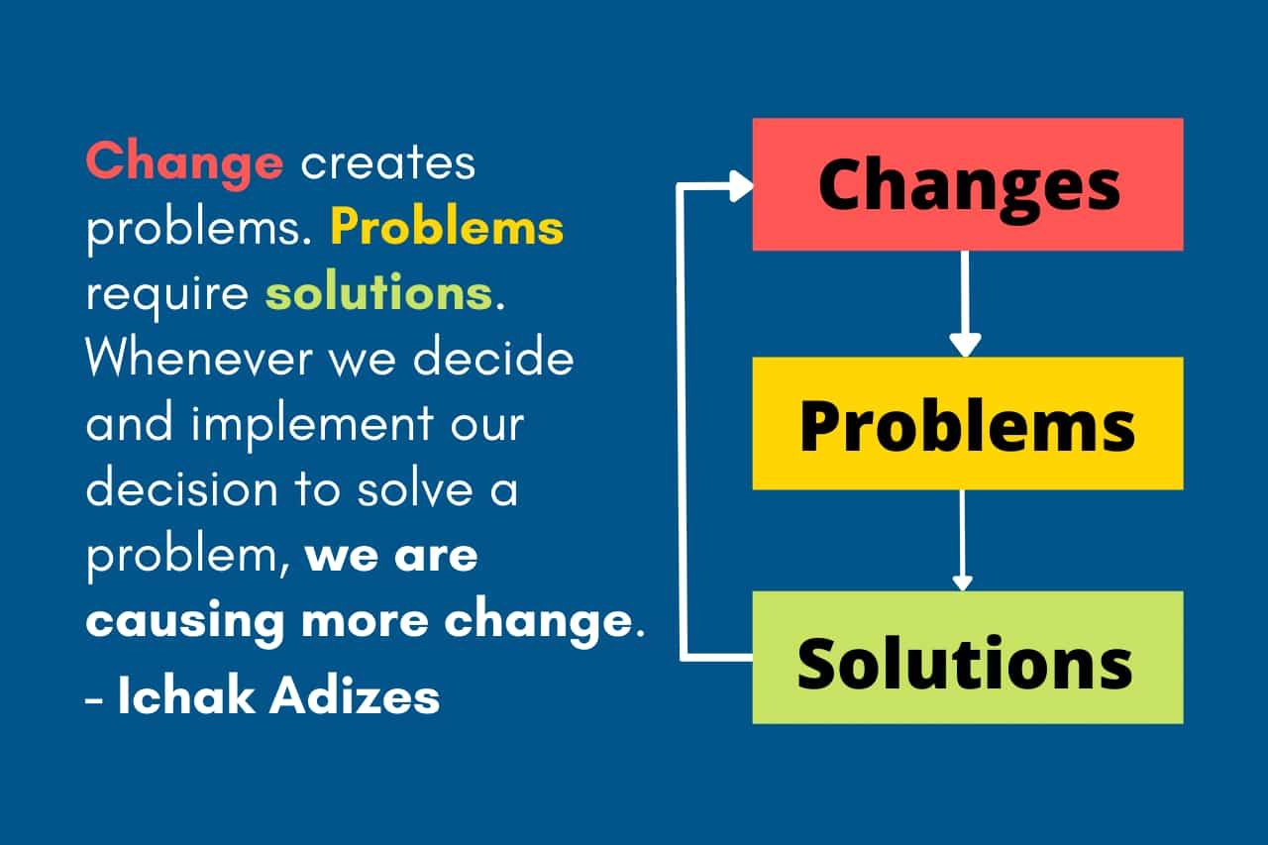
What is Problem-Solving
Uncertainty is something that brings more alternatives to choose from and something that makes more directions and paths available to us. The decisions and decision-making are directly related to the problem-solving process, or decision-making is part of the problem-solving process.
According to Ichak Adizes, there is a direct link between change, problems, and solutions. Any change in the current situation in a company, family, or personal life is a source of the problem. So before every problem, there is a change, the basic reason for solving a problem. Problems, however, require a solution, which is a kind of decision.

Slide 37

Decision-Making Models
Rational decision-making models
Most people will make decisions based on emotion rather than logic. This is because emotions are much easier to understand and act upon. When making decisions, however, it is important to be logical and make sure you are not missing out on something that could potentially help your team or company.
It’s not always easy to make the right decision. If you are in a situation where you need to decide between two options, it’s hard to avoid bias. However, you can still make the best decision if you take a step back and consider all the different perspectives.
Intuitive decision-making models
Intuitive decisions are decision-making models that use gut instincts. This model requires previous experience and pattern recognition to form strong instincts. Decision-makers with a lot of experience with similar problems often use intuitive models.
Creative decision-making model
The creative decision-making model is a great way to generate solutions to problems. It’s often referred to as the “no-think” approach because instead of actively thinking about how to solve a problem, you let your subconscious mind do it for you. When doing this, you can spend more time developing innovative solutions rather than worrying about whether or not you are doing the right thing.
Creative decision-making is an alternative to the rational decision-making model. It’s a useful tool for entrepreneurs and business leaders who need to make decisions quickly without taking the time to evaluate the best options. It’s also a great way to brainstorm solutions to problems because it helps you relax and focus on your creative process.

Slide 38

How do you make decisions to solve problems?
See Notes

